Slide 1
Lecture 7
Requirements Elicitation
Muhammad Qasim
BSCS (Software Engineering-I) SZABIST-Islamabad

Slide 2
Requirements Elicitation
Requirements elicitation is the practice of collecting the requirements of a system from users, customers and other stakeholders. The practice is also sometimes referred to as requirements gathering.
BSCS (Software Engineering-I) SZABIST-Islamabad

Slide 3
Requirements Elicitation Techniques
Stakeholder Analysis
Brainstorming
Document Analysis
Focus Group
Interface Analysis
Interview
  One On One Interview
  Group Interview
Observation
Prototyping
Joint Application Development (JAD)
Questionnaire/Survey
Reverse Engineering
BSCS (Software Engineering-I) SZABIST-Islamabad

Slide 4
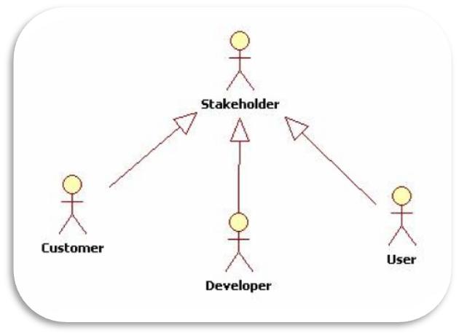
Stakeholder Analysis
Stakeholder analysis identifies all the users and stakeholders who may influence or be impacted by the system. This helps ensure that the needs of all those involved are taken into account
BSCS (Software Engineering-I) SZABIST-Islamabad

Slide 5
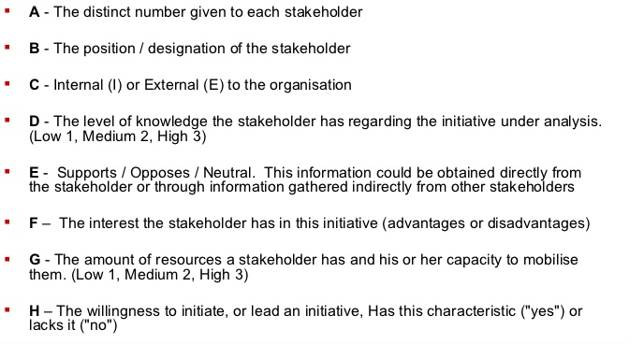
Stakeholder Analysis
BSCS (Software Engineering-I) SZABIST-Islamabad

Slide 6
Stakeholder Analysis
Benefits
Ensures that all relevant stakeholders are considered
All important stakeholders are captured, and yet that irrelevant actors are not included
Drawbacks
There is a danger that too much time is spent on identifying roles and relationships, and the team is swamped with data.
BSCS (Software Engineering-I) SZABIST-Islamabad

Slide 7
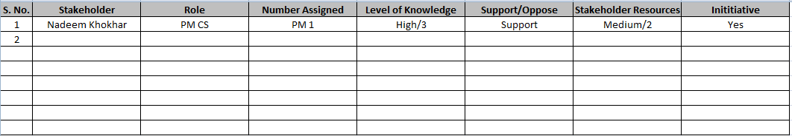
Stakeholder Analysis Sheet
BSCS (Software Engineering-I) SZABIST-Islamabad

Slide 8
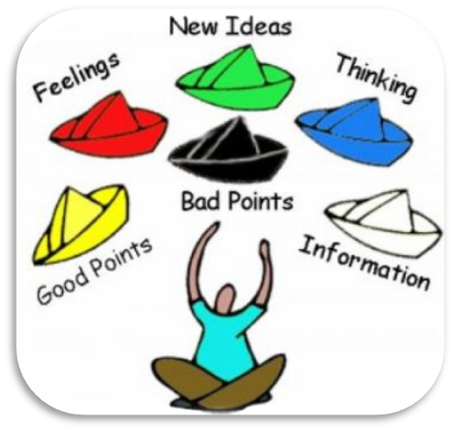
Brainstorming (informal debate)
Brainstorming is used in requirement gathering to get as many ideas as possible from group of people. Generally used to identify possible solutions to problems, and clarify details of opportunities.
Benefits
Generate a variety of ideas in a short time
Produce new and creative ideas
Risks
The risk of having a bad session
Making staff scared to voice their ideas because they were criticized in the session
Problems normally occur if you only use traditional brainstorming techniques
BSCS (Software Engineering-I) SZABIST-Islamabad

Slide 9

Document Analysis
Review existing documentation – Document Analysis is a means to elicit requirements of an existing system by studying available documentation and identifying relevant information.
In an ideal world, we would even be reviewing the requirements that drove creation of the existing system – a starting point for documenting current requirements. Nuggets of information are often buried in existing documents that help us ask questions as part of validating requirement completeness.
Benefits
Validating the requirement completeness.
Chunks of information are mostly buried in present documents
A beginning point for documenting all current requirements.
Risks & Drawbacks
Time Consuming
Conflicts
Exhausted
Not Found Real Figures
BSCS (Software Engineering-I) SZABIST-Islamabad

Slide 10

Focus Group(SMEs)
A focus group is a good way to gather together people from similar backgrounds or experiences to discuss a specific topic of interest.
The feedback can be gathered about needs/opportunities/ problems to identify requirements, or can be gathered to validate and refine already elicited requirements.
Benefits
Managed process with particular participants
refine and validate the already elicited requirements
Allows analyst to rapidly obtain a wide variety of user views and possibly a consensus.
Risks & Drawbacks
following the crowd and some people think that focus groups are at best unproductive
Assemble groups. Dominant participants may influence group disproportionately
BSCS (Software Engineering-I) SZABIST-Islamabad

Slide 11
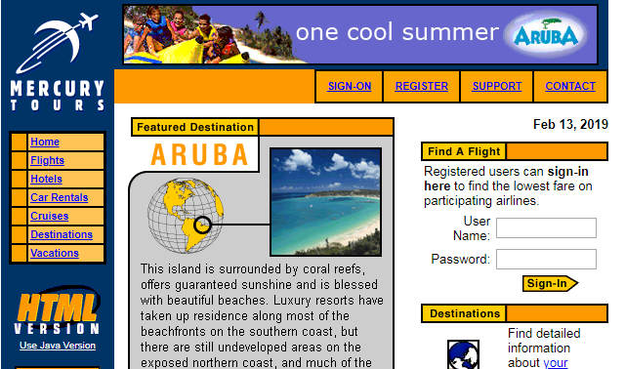
Interface Analysis
Interface Analysis is a business analysis elicitation technique that helps to identify interfaces between solutions/applications to determine the requirements for ensuring that the components interact with one another effectively.
Interface analysis – reviewing the touch points with other external systems is important to make sure we don’t overlook requirements that aren’t immediately visible to users..
BSCS (Software Engineering-I) SZABIST-Islamabad

Slide 12
Interviews
An interview is a systematic approach designed to elicit information from a person or group of people in an informal or formal setting by talking to an interviewee, asking relevant questions and documenting the responses.
One2One
Group
BSCS (Software Engineering-I) SZABIST-Islamabad

Slide 13

One On One Interview
The most common technique for gathering requirements is to sit down with the clients and ask them what they need. The discussion should be planned out ahead of time based on the type of requirements you’re looking for
Benefits
Privacy of everyone
in-depth a stakeholder’s thoughts and get his or her perspective
Risks & Drawbacks
Time Consuming
Misunderstandings
BSCS (Software Engineering-I) SZABIST-Islamabad

Slide 14

Group Interview
If there are more then one person during interview usually 2 or 4 these people must be on some level must be on some level less time required
Benefits
we can get hidden requirements
uncover a richer set of requirements in a shorter period of time
Uncover ambiguities
Risks & Drawbacks
Not relaxed environment
Conflicts
The allotted time have been exhausted
BSCS (Software Engineering-I) SZABIST-Islamabad

Slide 15
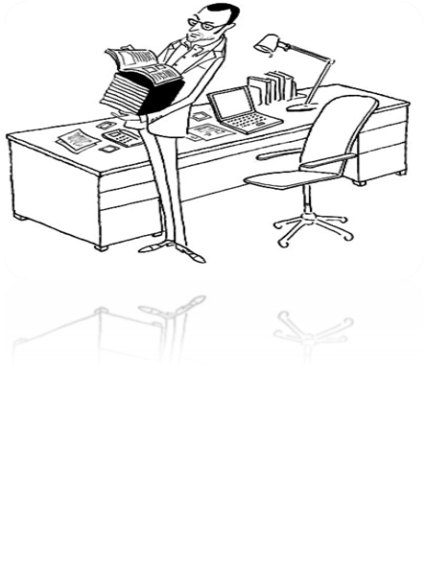
Observation/ Job shadowing
Observation is a means of eliciting requirements by conducting an assessment of the stakeholder’s work environment. This technique is appropriate when documenting details about current processed or if the project is intended to enhance or change a current process.
Observations can be passive or active (asking questions while observing). Passive observation is better for getting feedback on a prototype (to refine requirements), where active observation is more effective at getting an understanding of an existing business process. Either approach can be used
Benefits
The ability to record and report all findings that are true
it is more practical
no long calculation has to be done
Risks & Drawbacks
The viewer's or researcher's own perception
few trials/studies/or objects observed to make an end conclusion
results may contain human error
BSCS (Software Engineering-I) SZABIST-Islamabad

Slide 16
Prototyping
Storyboarding, navigation flow, paper prototyping, screen flows – Prototyping details user interface requirements and integrates them with other requirements such as use cases, scenarios, data, and business rules. Stakeholders often find prototyping to be a concrete means of identifying, describing and validating their interface needs.
Prototyping is a relatively modern technique for gathering requirements. In this approach, you gather preliminary requirements that you use to build an initial version of the solution - a prototype. You show this to the client, who then gives you additional requirements. You change the application and cycle around with the client again. This repetitive process continues until the product meets the critical mass of business needs or for an agreed number of iterations.
BSCS (Software Engineering-I) SZABIST-Islamabad

Slide 17
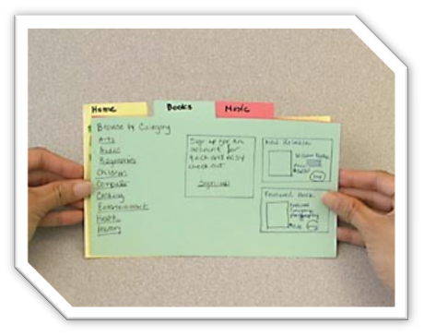
Prototyping
Benefits
prototypes can be ideal reduce design risk
it is more practical
Screen mock-ups
Using animation tools
provides an understanding of functionality
Risks & Drawbacks
takes time to build
more costly to build
false sense of security
BSCS (Software Engineering-I) SZABIST-Islamabad

Slide 18
Joint Application Development (JAD)/Workshops
JAD or joint application design, these workshops can be efficient for gathering requirements. Workshops can be very effective for gathering requirements. More structured than a brainstorming session, involved parties collaborate to document requirements. One way to capture the collaboration is with creation of domain-model artifacts (like static diagrams, activity diagrams). A workshop will be more effective with two analysts than with one.
Benefits
group typically stays in the session until the session objectives are completed
participants stay in session until a complete set of requirements
documented and agreed to
Risks & Drawbacks
takes time to build
more costly to build
false sense of security
BSCS (Software Engineering-I) SZABIST-Islamabad

Slide 19
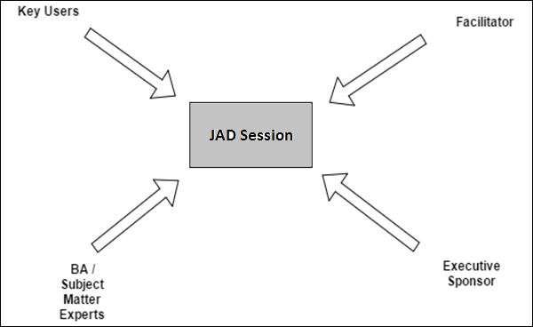
Joint Application Development (JAD)
BSCS (Software Engineering-I) SZABIST-Islamabad

Slide 20
Reverse Engineering
When a migration project does not have access to sufficient documentation of the existing system, reverse engineering will identify what the system does. It will not identify what the system should do, and will not identify when the system does the wrong thing.
Benefits
Less Cost
Can improve product
Risks & Drawbacks
Time consuming
BSCS (Software Engineering-I) SZABIST-Islamabad

Slide 21
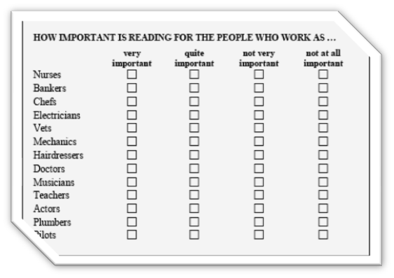
Survey/Questionnaire
When collecting information from many people – too many to interview with budget and time constraints – a survey or questionnaire can be used. The survey can force users to select from choices, rate something (“Agree Strongly, agree…”), or have open ended questions allowing free-form responses. Survey design is hard – questions can bias the respondents.
Benefits
Less cost
Reach Large No of Peoples
The responses are gathered in a standardized way
Risks & Drawbacks
Difficult filling for users
participants may forget important issues
Stockholders may not be willing to answer the questions
BSCS (Software Engineering-I) SZABIST-Islamabad

Slide 22
Reference Website for Activity
Analyze the given User Interface to gather requirements.
    User Name: user
    Password: 12345
http://newtours.demoaut.com/
BSCS (Software Engineering-I) SZABIST-Islamabad

Slide 23
Activity-II
Prepare 10 interview questions for the above given scenario.
BSCS (Software Engineering-I) SZABIST-Islamabad

